Slide 1

FLUTTER
Feb
REWIND 2019
Jun
May
Apr
Mar
Jan

Slide 2

Jun
Apr
Feb
May
Mar
Jan
WHATSUPCODERS
Whatsupcoders offers you tons of free tutorials related to Flutter and helps you build real Flutter projects. Join me on my adventures!!

Slide 3



1
2
3
Jun
FLUTTER CREATE
FLUTTER 1.2
MWC
FLUTTER YOUTUBE
Feb
May
Apr
Mar
Jan

Slide 4
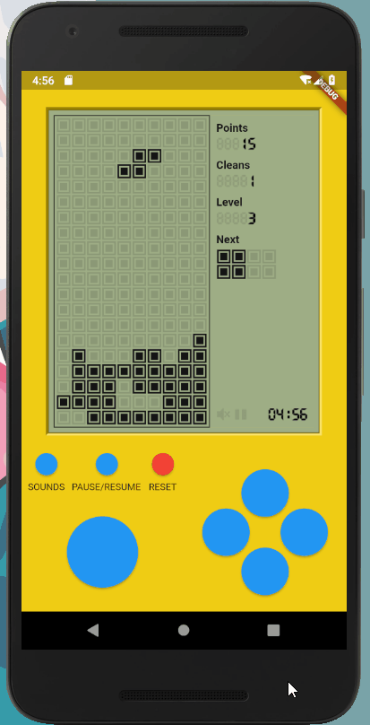


TETRIS
MWC
Jun
Feb
May
Apr
Mar
Jan
Dream11

Slide 5



Jun
Feb
May
Apr
Mar
Jan
WIDGET OF THE WEEK
FLUTTER MEETUP
FLUTTER ARKIT

Slide 6



GoogleIO 2019
I/O brings together developers from around the globe for talks, hands-on learning with Google experts, and a first look at Google’s latest developer products.
Developer Quest Game
Today, as part of Google I/O 2019, we’re excited to release Flutter Developer Quest, a game built entirely in Flutter
Jun
May
Feb
Apr
Mar
Jan
GDE interviews
Interviewed Google Experts on Whatsupcoders

Slide 7






FLUTTER INTERNATIONAL HACKATHON 2019
13
Jun
Feb
May
Apr
12
14
Mar
Jan
10
6
12

Slide 8
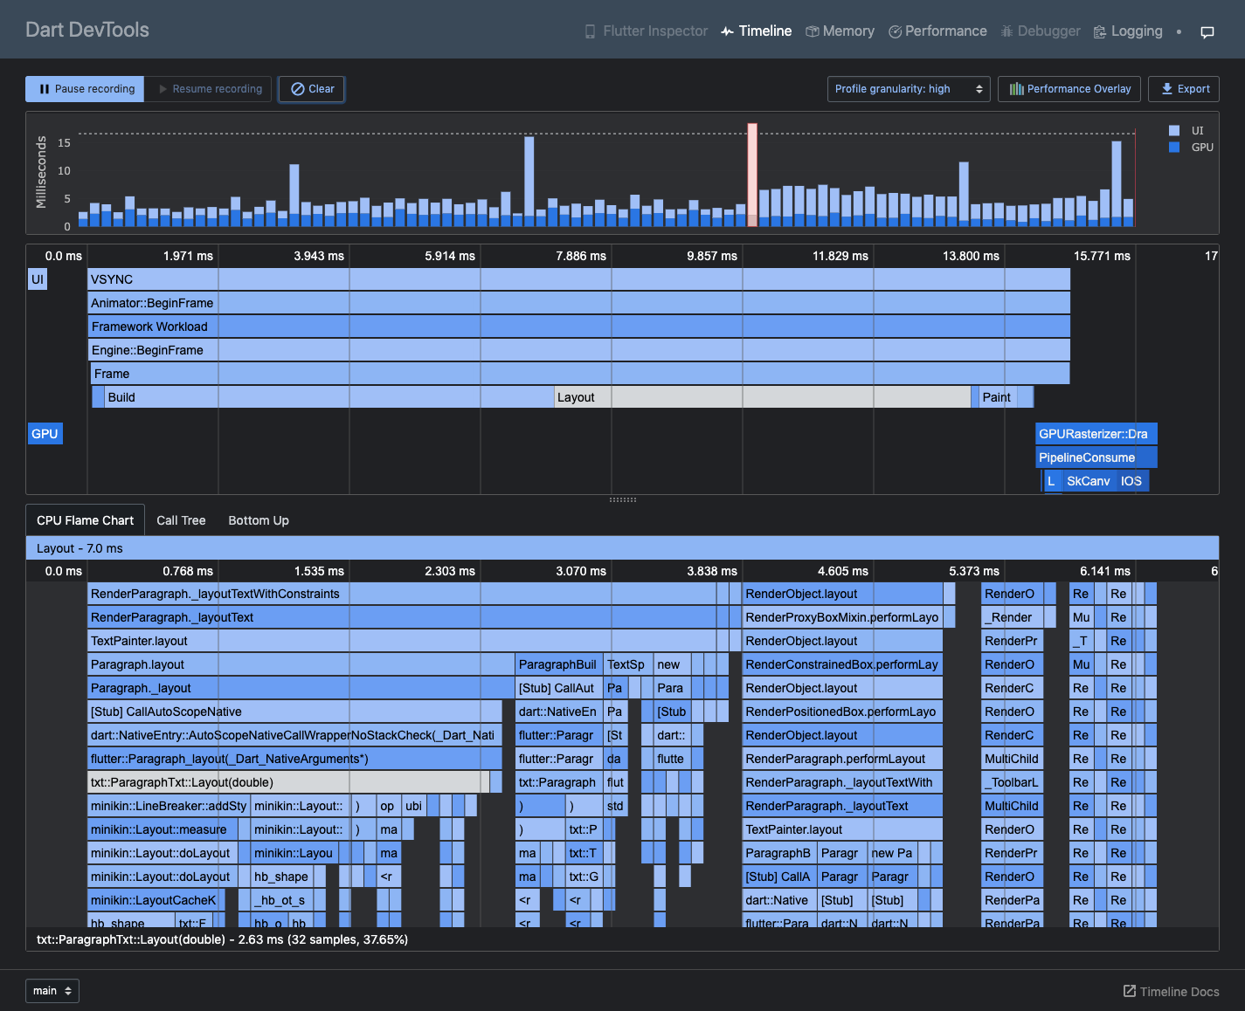
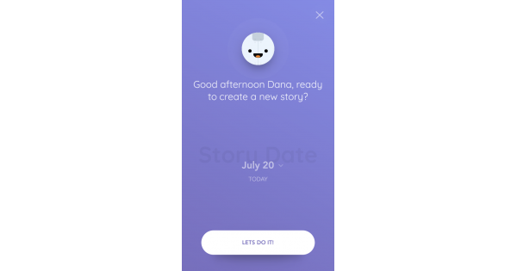
DEVTOOLS
DevTools is a suite of performance and debugging tools for Dart and Flutter. It’s currently in preview release but is under active development.
Jun
Feb
May
Apr
Mar
Jan
REFLECTLY
Reflectly’s mission was to create a beautifully designed app to counter the stress of social media and technology. The team turned to Flutter to create a user-friendly app that worked seamlessly on both iOS and Android.

Slide 9
Flutter 1.7
Flutter 1.7 contains support for AndroidX and for updated Play Store requirements, a number of new and enhanced components, and bug fixes to customer-reported issues.
Maze Game
Flutter Mazegen is a project to generate mazes in Flutter. Chris was inspired to dust off some old C++ code and make it run on Flutter.
Dec
Oct
Aug
Nov
Sep
Jul
BeforeAfterPlugin
A flutter package which makes it easier to display the difference between two images.

Slide 10
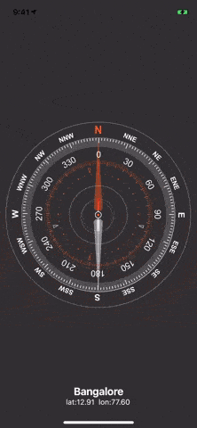

Dec
Aug
Nov
Oct
Sep
Jul

Slide 11



Dec
Aug
Nov
Oct
Sep
Jul
Flutter 1.9
Dart 2.5
Flutter Europe

Slide 12


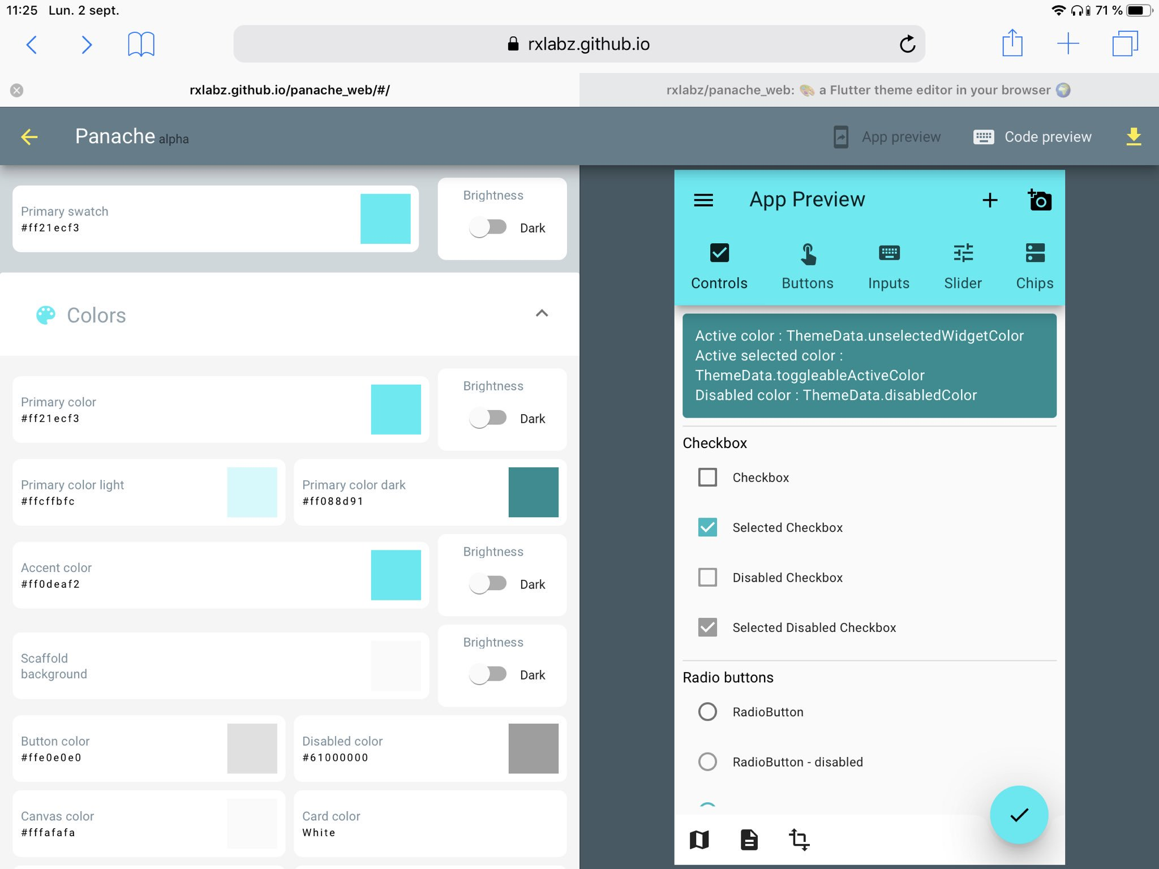
FLUTTER TRENDING
GDE SUMMIT
Dec
Aug
Nov
Oct
Sep
Jul
PageTurn
Flutter Theme Editor

Slide 13
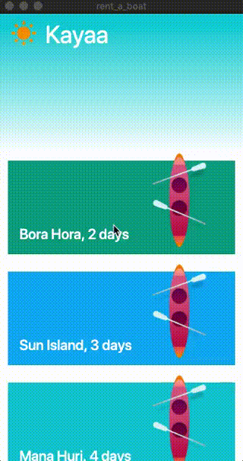
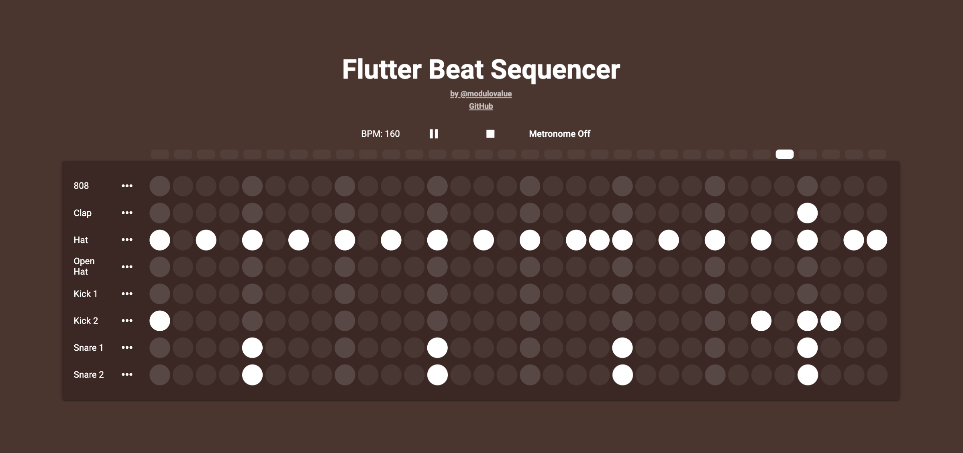
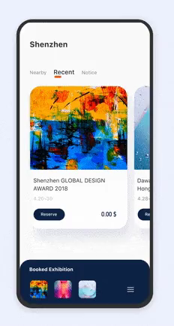
Dec
Nov
Aug
Oct
Sep
Jul

Slide 14

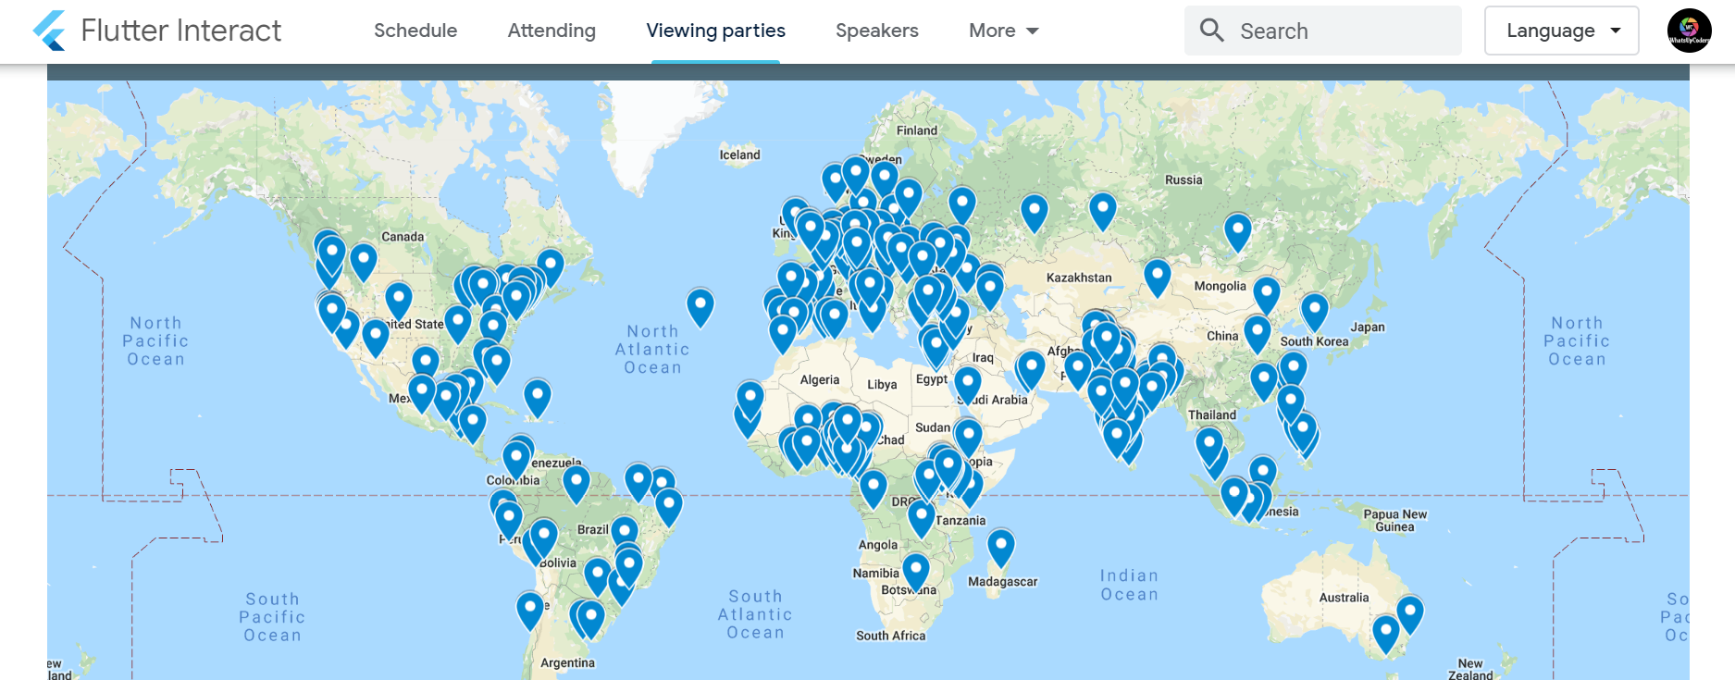
Flutter Interact
Flutter Interact Viewing Parties
Dec
Aug
Nov
Oct
Sep
Jul

Slide 15



FLUTTERWEEKLY
HUMPDAY Q&A
Aug
Dec
Nov
Oct
Sep
Jul
FLUTTER TIPS

